Slide 1
Chapter 18 - C++ Operator Overloading
Outline
18.1 Introduction
18.2 Fundamentals of Operator Overloading
18.3 Restrictions on Operator Overloading
18.4 Operator Functions as Class Members vs. as friend Functions
18.5 Overloading Stream-Insertion and Stream-Extraction Operators
18.6 Overloading Unary Operators
18.7 Overloading Binary Operators
18.8 Case Study: An Array Class
18.9 Converting between Types
18.10 Overloading ++ and --

Slide 2
Objectives
In this chapter, you will learn:
  To understand how to redefine (overload) operators to work with new types.
  To understand how to convert objects from one class to another class.
  To learn when to, and when not to, overload operators.
  To study several interesting classes that use overloaded operators.
  To create an Array class.

Slide 3
18.1 Introduction
Chapter 16 and 17
  ADT’s and classes
  Function-call notation is cumbersome for certain kinds of classes, especially mathematical classes
In this chapter
  We use C++’s built-in operators to work with class objects

Slide 4
18.1 Introduction
Operator overloading
  Use traditional operators with user-defined objects
  Straightforward and natural way to extend C++
  Requires great care
    When overloading is misused, programs become difficult to understand

Slide 5
18.2 Fundamentals of Operator Overloading
Use operator overloading to improve readability
  Avoid excessive or inconsistent usage
Format
  Write function definition as normal
  Function name is keyword operator followed by the symbol for the operator being overloaded.
  operator+ would be used to overload the addition operator (+)

Slide 6
18.2 Fundamentals of Operator Overloading
Assignment operator (=)
  may be used with every class without explicit overloading
  memberwise assignment
  Same is true for the address operator (&)

Slide 7
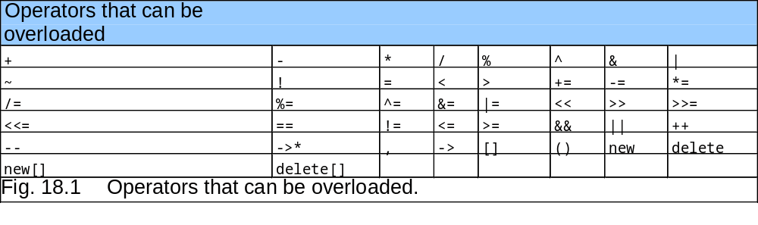
18.3 Restrictions on Operator Overloading
Most of C++’s operators can be overloaded

Slide 8
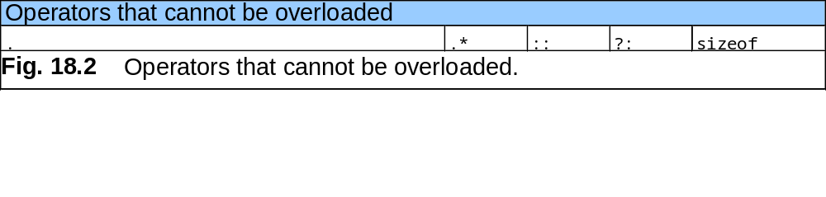
18.3 Restrictions on Operator Overloading

Slide 9
18.3 Restrictions on Operator Overloading
Arity (number of operands) cannot be changed
  Unary operators remain unary, and binary operators remain binary
  Operators &, *, + and - each have unary and binary versions
    Unary and binary versions can be overloaded separately

Slide 10
18.3 Restrictions on Operator Overloading
No new operators can be created
  Use only existing operators
Built-in types
  Cannot overload operators
  You cannot change how two integers are added

Slide 11
18.4 Operator Functions as Class Members vs. as friend Functions
Operator functions
  Can be member or non-member functions
Overloading the assignment operators
  i.e:(), [], ->,=
  Operator must be a member function

Slide 12
18.4 Operator Functions as Class Members vs. as friend Functions
Operator functions as member functions
  Leftmost operand must be an object (or reference to an object) of the class
  If left operand of a different type, operator function must be a non-member function
  A non-member operator function must be a friend if private or protected members of that class are accessed directly

Slide 13
18.4 Operator Functions as Class Members vs. as friend Functions
Non-member overloaded operator functions
  Enable the operator to be commutative
  HugeInteger bigInteger1;
  long int number;
  bigInteger1 = number + bigInteger1;
  or
  bigInteger1 = biginteger1 + number;

Slide 14
18.5 Overloading Stream-Insertion and Stream-Extraction Operators
Overloaded << and >> operators
  Must have left operand of types ostream &, istream & respectively
  It must be a non-member function (left operand not an object of the class)
  It must be a friend function if it accesses private data members

Slide 15
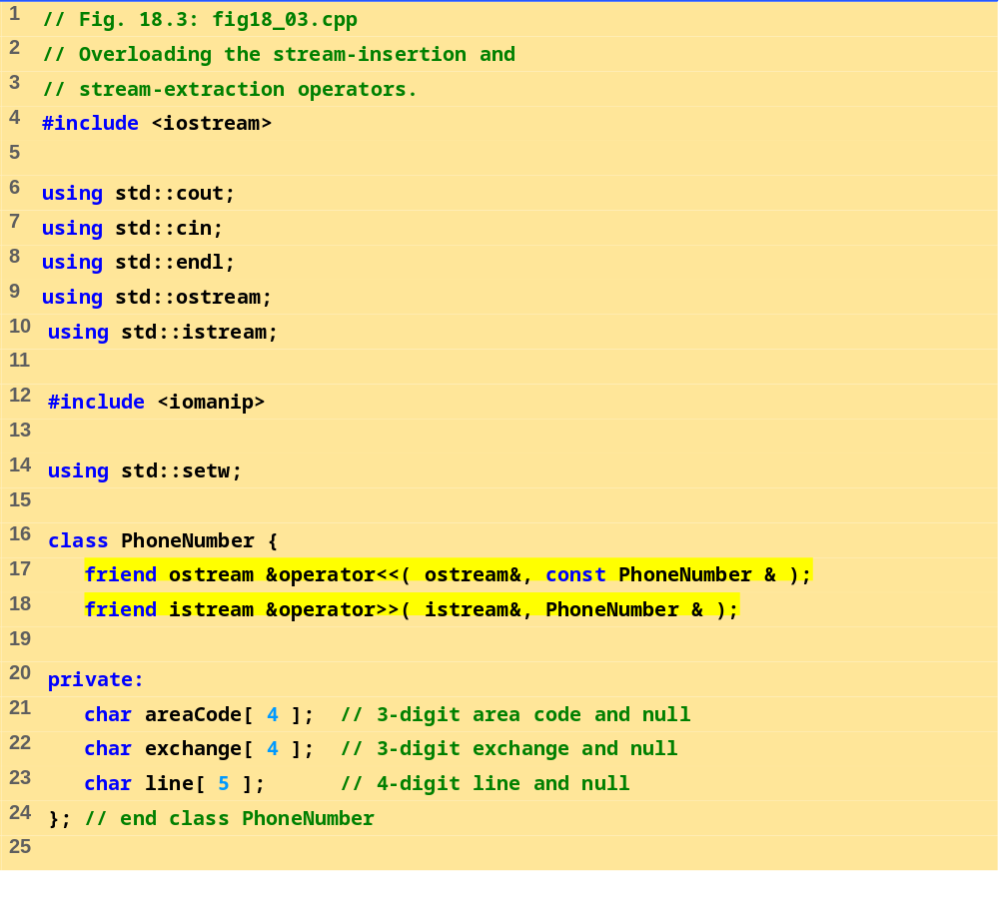
fig18_03.cpp (1 of 3)

Slide 16
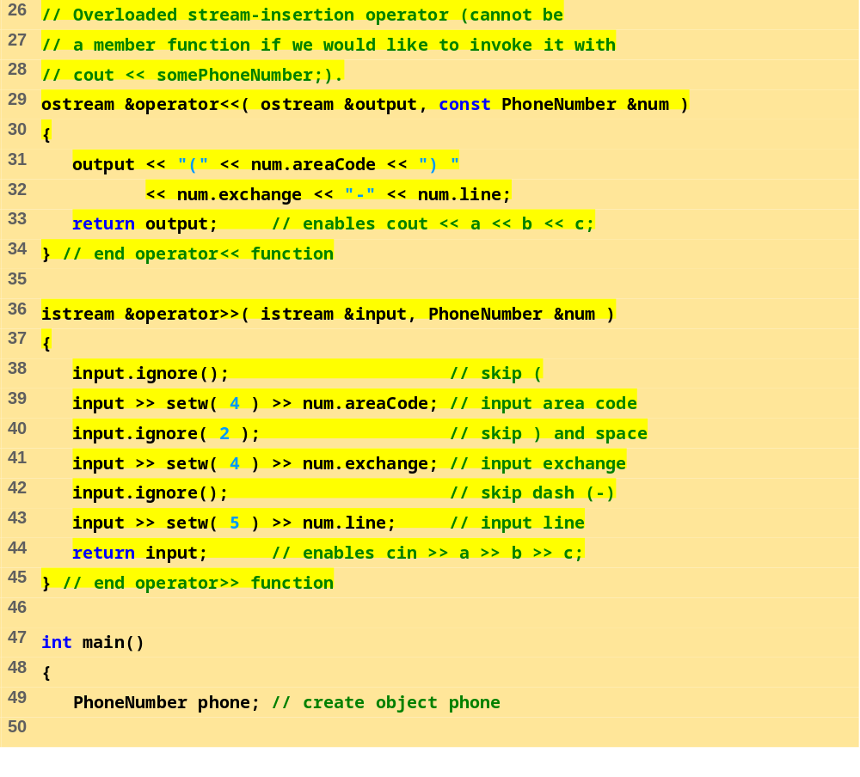
fig18_03.cpp (2 of 3)

Slide 17
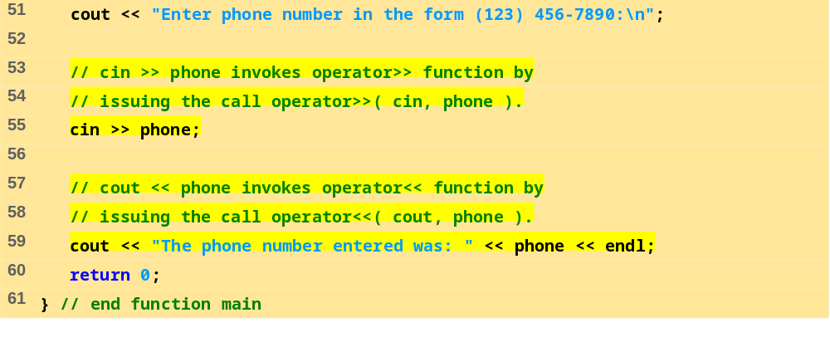
fig18_03.cpp (3 of 3)
Enter phone number in the form (123) 456-7890:
(800) 555-1212
The phone number entered was: (800) 555-1212

Slide 18
18.6 Overloading Unary Operators
Overloading unary operators
  Avoid friend functions and friend classes unless absolutely necessary.
  Use of friends violates the encapsulation of a class.
  As a member function:
  class String {
  public:
  bool operator!() const;
  ...
  };

Slide 19
18.7 Overloading Binary Operators
Overloaded binary operators
  Non-static member function, one argument
  Non-member function, two arguments
class String {
public:
const String &operator+=( const String & );
...
}; // end class String
  y += z;
  equivalent to
  y.operator+=( z );

Slide 20
18.7 Overloading Binary Operators
Example
class String {
friend const String &operator+=( String &,
const String & );
...
}; // end class String
  y += z;
  equivalent to
  operator+=( y, z );

Slide 21
18.8 Case Study: An Array class
Implement an Array class with
  Range checking
  Array assignment
  Arrays that know their size
  Outputting/inputting entire arrays with << and >>
  Array comparisons with == and !=

Slide 22
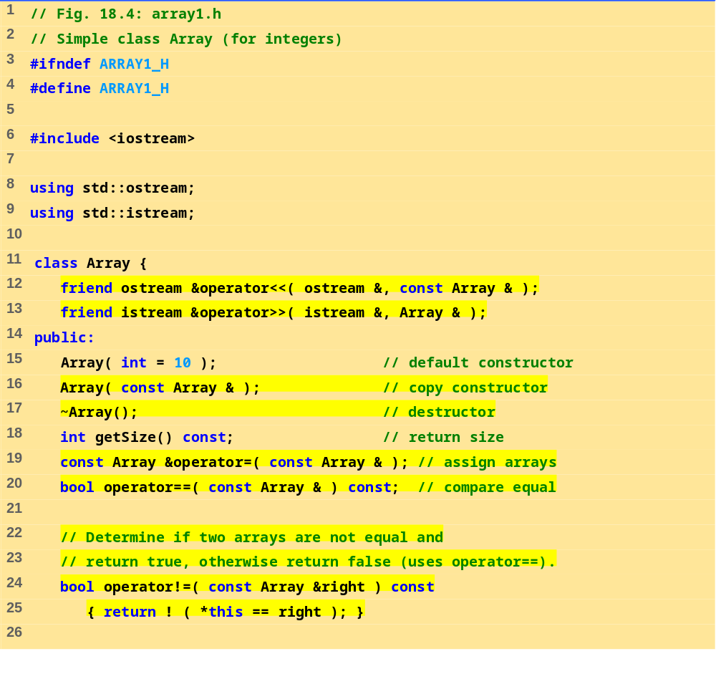
array1.h (1 of 2)

Slide 23
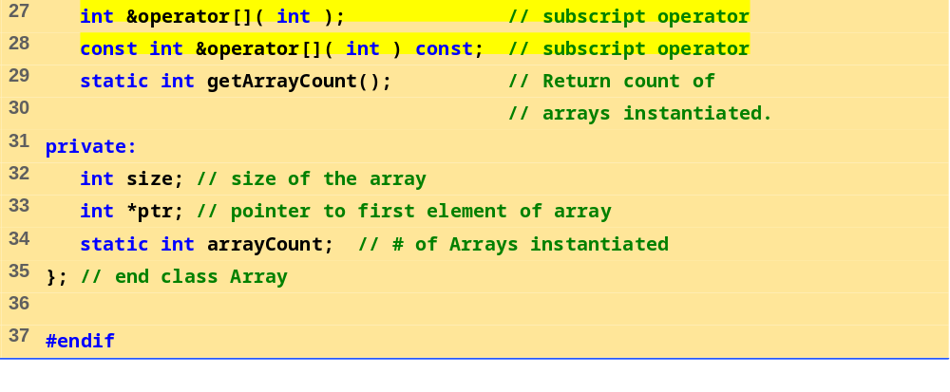
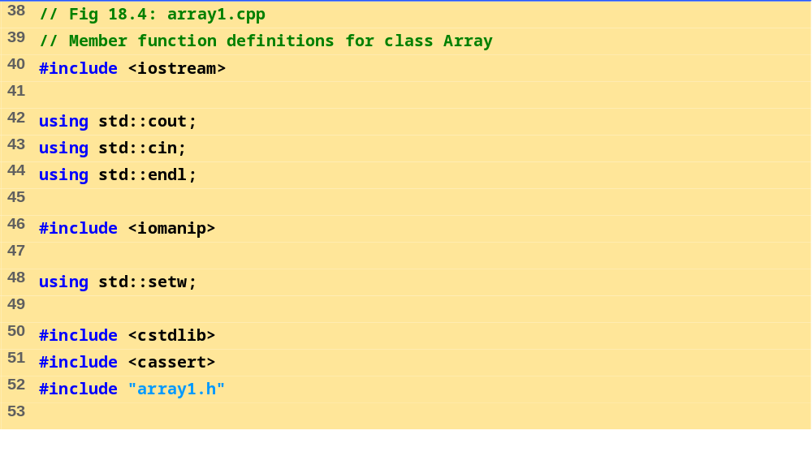
array1.h (2 of 2)
array1.cpp (1 of 6)

Slide 24
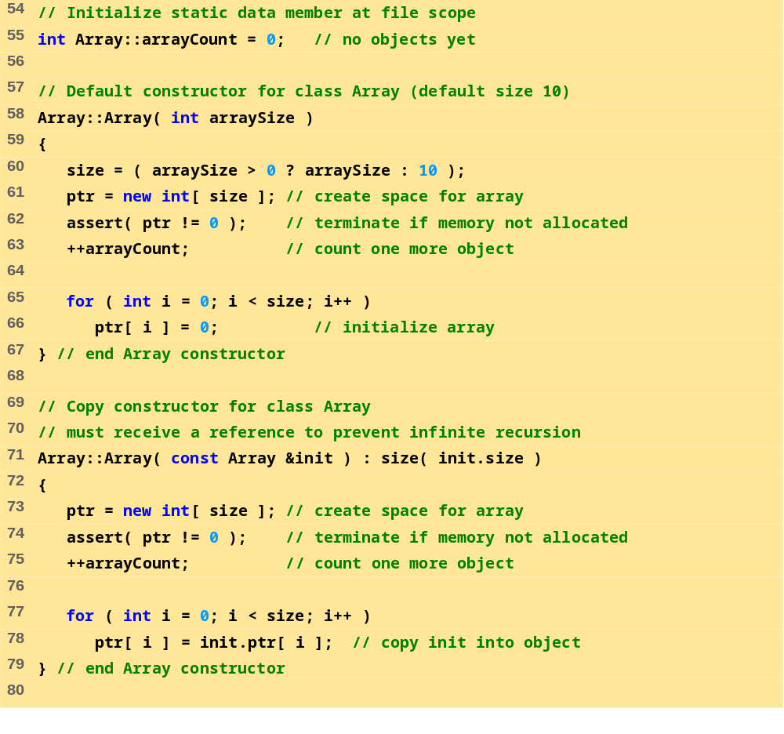
array1.cpp (2 of 6)

Slide 25
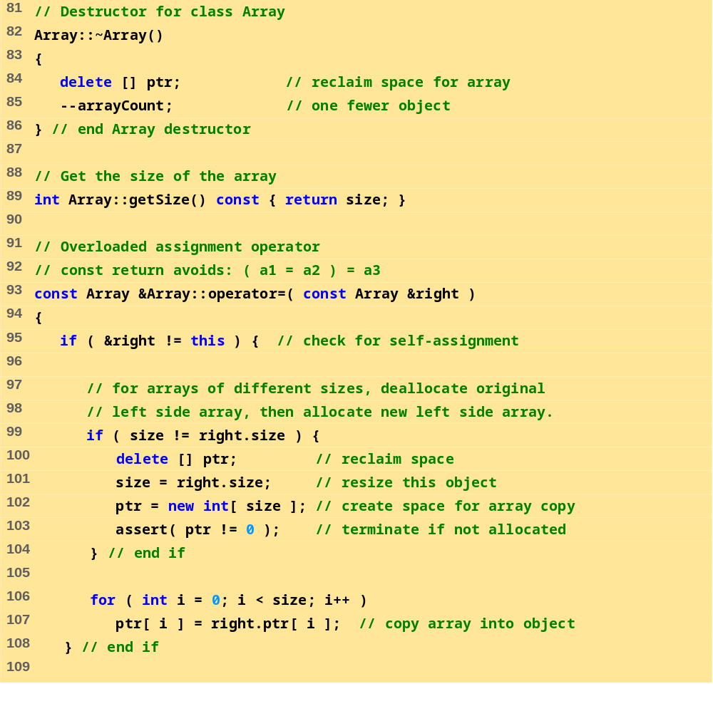
array1.cpp (3 of 6)

Slide 26
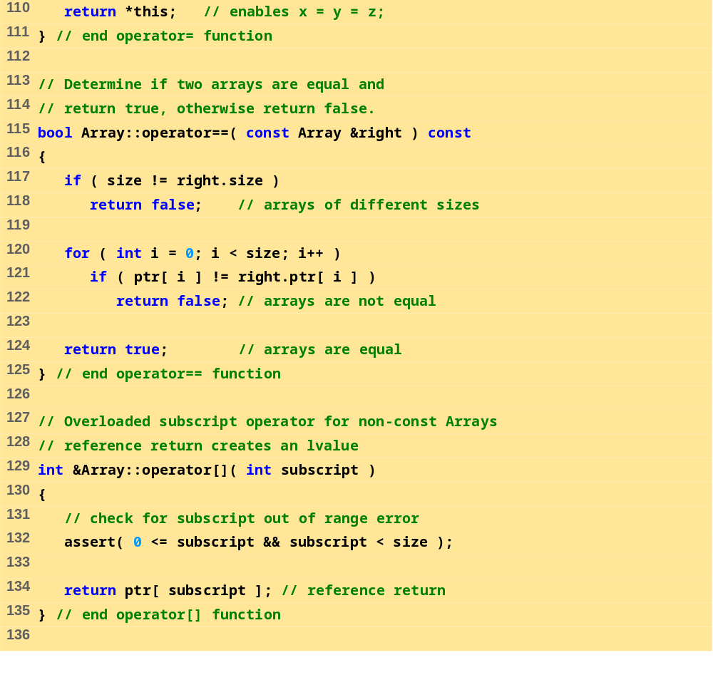
array1.cpp (4 of 6)

Slide 27
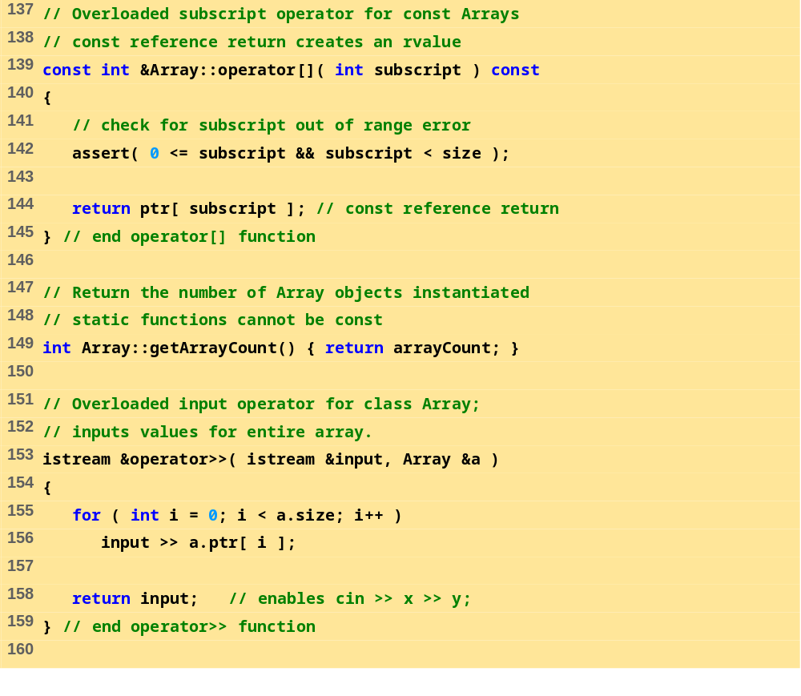
array1.cpp (5 of 6)

Slide 28
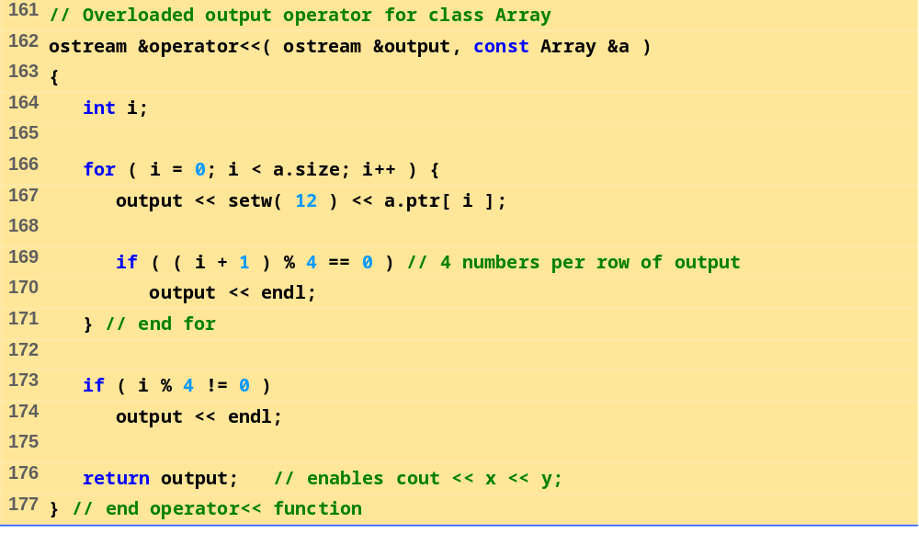
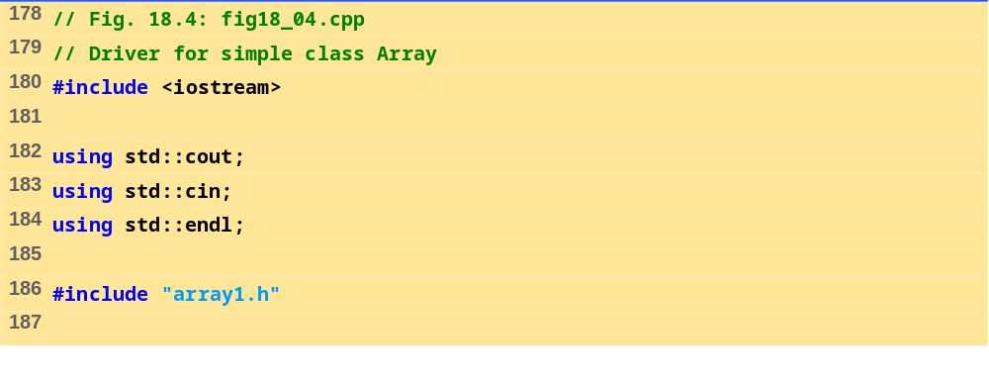
array1.cpp (6 of 6)
fig18_04.cpp (1 of 4)

Slide 29
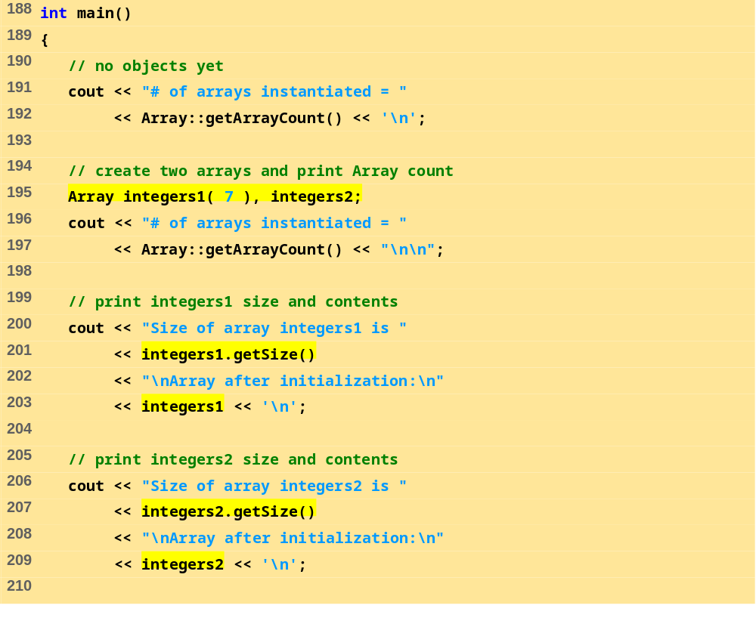
fig18_04.cpp (2 of 4)

Slide 30
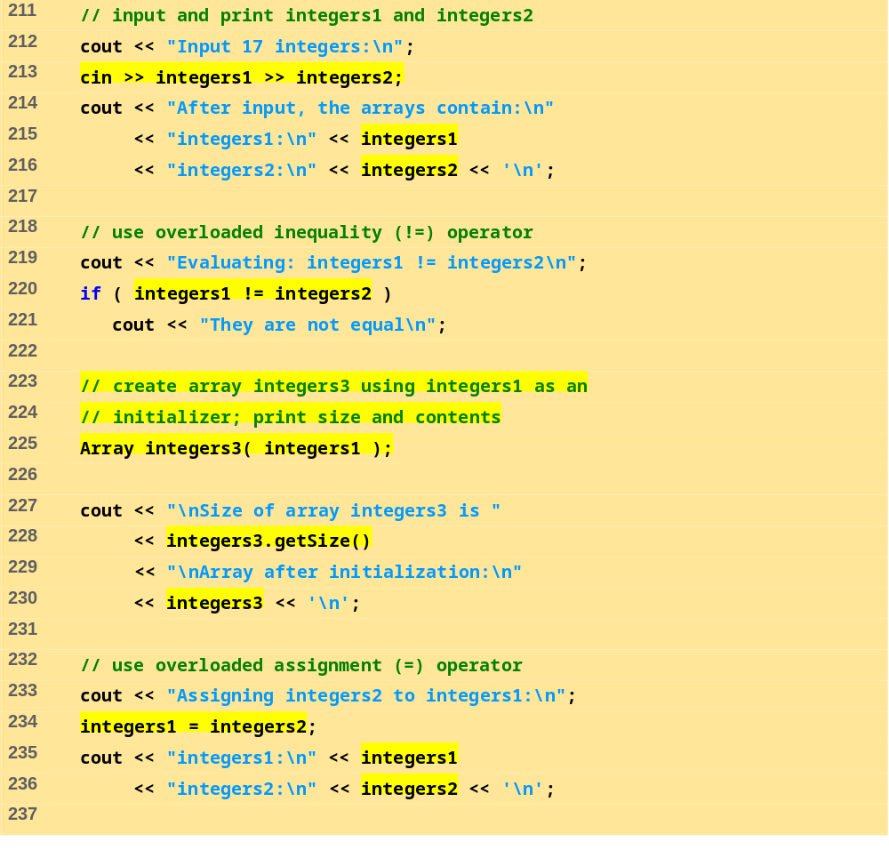
fig18_04.cpp (3 of 4)

Slide 31
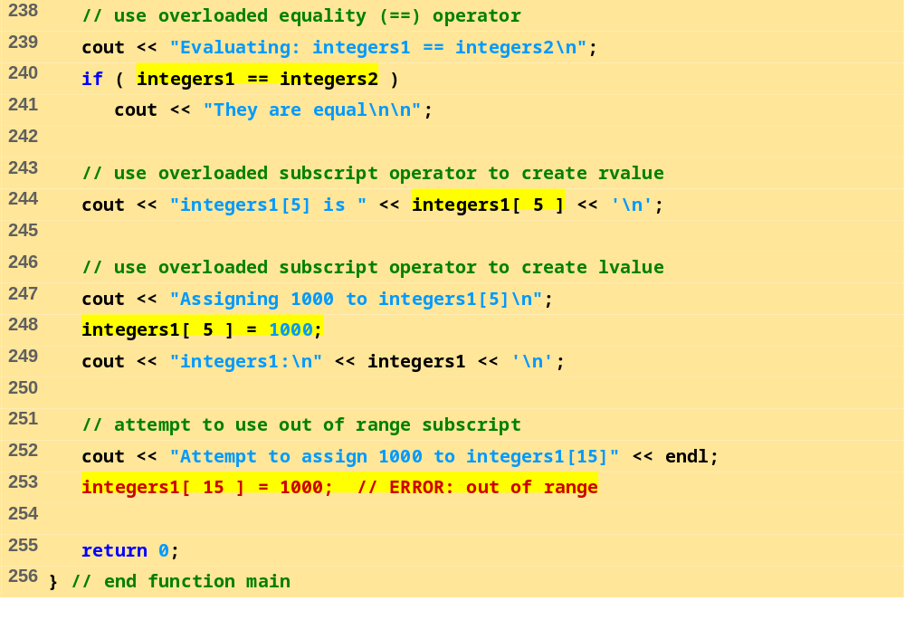
fig18_04.cpp (4 of 4)

Slide 32
# of arrays instantiated = 0
# of arrays instantiated = 2
Size of array integers1 is 7
Array after initialization:
0 0 0 0
0 0 0
Size of array integers2 is 10
Array after initialization:
0 0 0 0
0 0 0 0
0 0
Input 17 integers:
1 2 3 4 5 6 7 8 9 10 11 12 13 14 15 16 17
After input, the arrays contain:
integers1:
1 2 3 4
5 6 7
integers2:
8 9 10 11
12 13 14 15
16 17
Evaluating: integers1 != integers2
They are not equal
Size of array integers3 is 7
Array after initialization:
1 2 3 4
5 6 7
Array output (1 of 1)

Slide 33
Assigning integers2 to integers1:
integers1:
8 9 10 11
12 13 14 15
16 17
integers2:
8 9 10 11
12 13 14 15
16 17
Evaluating: integers1 == integers2
They are equal
integers1[5] is 13
Assigning 1000 to integers1[5]
integers1:
8 9 10 11
12 1000 14 15
16 17
Attempt to assign 1000 to integers1[15]
Assertion failed: 0 <= subscript && subscript < size, file Array1.cpp, line 95 abnormal program termination
Array output (2 of 2)

Slide 34
18.9 Converting between Types
Cast operator
  Convert objects into built-in types or other objects
  Conversion operator must be a non-static member function.
  Cannot be a friend function
  Do not specify return type
  For user-defined class A
  A::operator char *() const;
  A::operator int() const;
  A::operator otherClass() const;
  When compiler sees (char *) s it calls
s.operator char*()

Slide 35
18.9 Converting between Types
The compiler can call these functions to create temporary objects.
  If s is not of type char *
  Calls A::operator char *() const; for
cout << s;

Slide 36
18.10 Overloading ++ and --
Pre/post-incrementing/decrementing operators
  Can be overloaded
  How does the compiler distinguish between the two?
  Prefix versions overloaded same as any other prefix unary operator would be. i.e. d1.operator++(); for ++d1;
Postfix versions
  When compiler sees postincrementing expression, such as d1++;
    Generates the member-function call
  d1.operator++( 0 );
  Prototype:
  Date::operator++( int );

